Slide 1
Introduction to Cluster Analysis in DMA
PRESENTED BY
Prajjaval Pandey
Made with SlideMaker.app

Slide 2
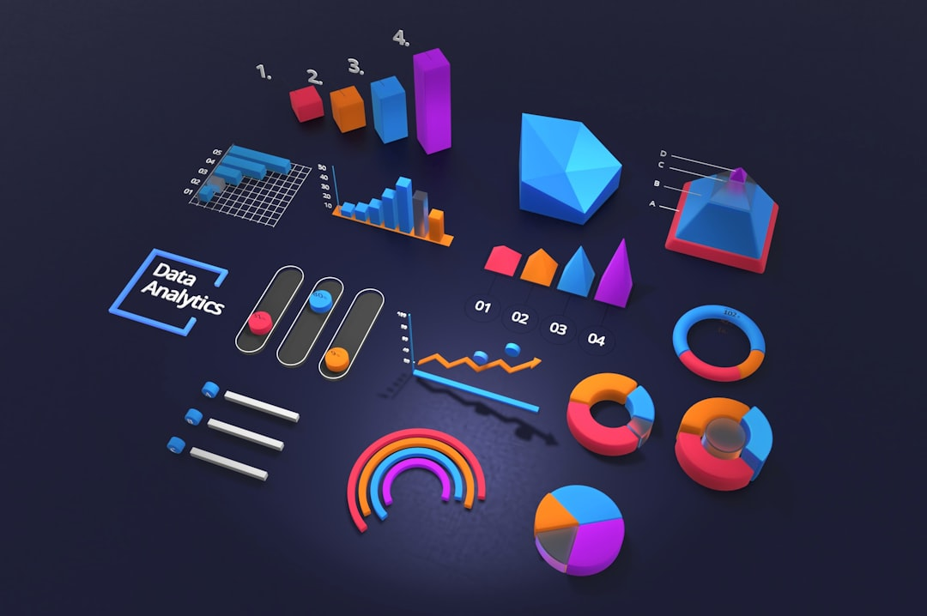
Introduction to Cluster Analysis in DMA
Cluster analysis is a powerful statistical method used in Data Mining and Analytics (DMA) to group similar data points. By identifying patterns and relationships within datasets, businesses can enhance decision-making, optimize marketing strategies, and improve customer segmentation. This presentation will explore the fundamentals of cluster analysis, its applications in DMA, and real-world examples demonstrating its effectiveness in driving insights and value. Understanding these concepts is crucial for leveraging data in today's competitive landscape.
Made with SlideMaker.app

Slide 3

What is Cluster Analysis?
Data Grouping Technique
Pattern Recognition
Cluster analysis groups data points based on similarities, allowing for the identification of distinct categories within large datasets, enhancing data interpretation.
This method helps uncover hidden patterns and relationships in data, which can lead to valuable insights and informed decision-making across various fields.
Applications Across Fields
Commonly utilized in marketing, biology, and social sciences, cluster analysis aids in segmenting customers, classifying species, and understanding social behaviors.
Made with SlideMaker.app

Slide 4



Types of Clustering Methods
K-means Clustering
Hierarchical Clustering
DBSCAN
K-means clustering partitions data into K distinct clusters by minimizing variance within each cluster. It is widely used for market segmentation and image compression.
Hierarchical clustering builds a tree of clusters, allowing for a multi-level analysis. It is useful for understanding data relationships and is often visualized using dendrograms.
DBSCAN identifies clusters based on density, effectively handling noise and varying cluster shapes. It is particularly useful in spatial data analysis and anomaly detection.
Made with SlideMaker.app

Slide 5
Clustering Method Performance Comparison
Made with SlideMaker.app

Slide 6



Applications of Cluster Analysis
Market Segmentation
Image Processing
Social Network Analysis
Cluster analysis identifies distinct customer groups, allowing businesses to tailor marketing strategies. For instance, 70% of companies report improved targeting through segmentation.
In image processing, cluster analysis enhances object recognition. Techniques like k-means clustering improve accuracy by 30% in identifying objects in complex images.
Cluster analysis reveals community structures in social networks. For example, it helps identify influential users, improving engagement strategies by 25%.
Made with SlideMaker.app

Slide 7


Real-World Applications of Cluster Analysis
1
Retail Customer Segmentation
Retailers like Amazon use clustering to segment customers based on purchasing behavior, enhancing targeted marketing strategies and increasing sales by up to 30%.
2
Healthcare Patient Analysis
Healthcare providers utilize clustering to analyze patient data, improving treatment plans and outcomes. For instance, clustering can identify high-risk patients for proactive care.
3
Fraud Detection in Finance
Financial institutions employ clustering techniques to detect fraudulent transactions, reducing fraud losses by approximately 20% through real-time anomaly detection.
4
Telecom Network Optimization
Telecommunications companies apply clustering to optimize network performance, enhancing service quality and reducing operational costs by analyzing usage patterns and traffic.
Made with SlideMaker.app

Slide 8
Transformative Impact of Cluster Analysis
20%
15%
30%
Increase in Sales
Reduction in Customer Acquisition Costs
Improvement in Patient Outcomes
Companies leveraging clustering techniques
Achieved through targeted marketing strategies
Healthcare organizations utilizing clustering
25%
Increase in Fraud Detection Accuracy
Enabled by advanced clustering algorithms
Made with SlideMaker.app

Slide 9
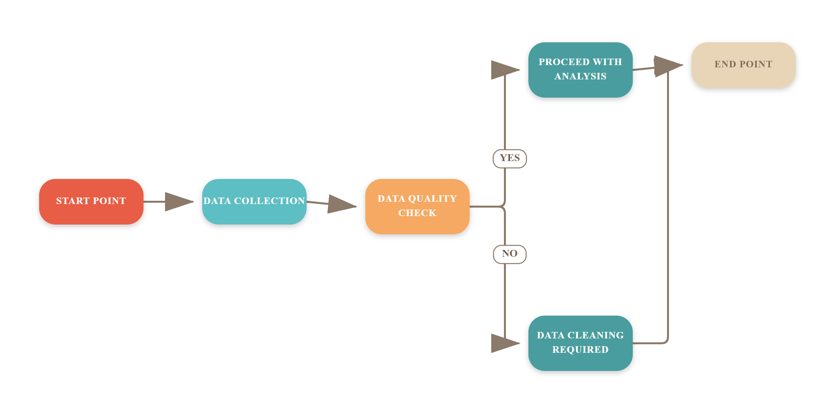
Steps in Cluster Analysis
Made with SlideMaker.app

Slide 10
Frequently Asked Questions
Q: What data types are suitable for clustering?
A: Clustering can be applied to various data types, including numerical, categorical, and mixed data, but the choice of algorithm may depend on the data type.
Q: How do I choose the right number of clusters?
A: The optimal number of clusters can be determined using methods like the Elbow Method or Silhouette Score, which evaluate the compactness and separation of clusters.
Q: What are the limitations of cluster analysis?
A: Cluster analysis can be sensitive to outliers and may produce different results based on the chosen algorithm and parameters, making it essential to validate findings.
Q: Can clustering be used for real-time data?
A: Yes, clustering can be adapted for real-time data, but it requires efficient algorithms and infrastructure to handle continuous data streams effectively.
Made with SlideMaker.app

Slide 11
Conclusion
In summary, cluster analysis in DMA reveals significant patterns that can enhance targeted marketing strategies. Key takeaways include identifying customer segments, optimizing resource allocation, and improving engagement. Moving forward, organizations should implement these insights to refine their approaches and leverage data-driven decisions for sustained growth. Embracing these strategies will not only enhance customer satisfaction but also drive profitability in an increasingly competitive landscape.
Made with SlideMaker.app

